Slide 1
Data 603 Project
Housing Affordability Index
Members:
David Griffin
Golin Chen
Haneen Al-Ramahi

Slide 2
Table of contents
Introduction
Dataset and Cleaning
Variable Determination
EDA
Model Building and Diagnostic
Model Refinement and Validation
Conclusion
References

Slide 3
Introduction
Context
Problem
Housing is at the forefront of Canadians minds
Growing concern for housing costs and economic stability
Overall: Address housing affordability within Canada
Various complex economic and social factors

Slide 4
Intent & Research Questions
What are the key factors driving the Housing Affordability Index?
Can we build a model to predict the Housing Affordability Index based on our selected economic indicators?
Can this model provide a minimum 90% accuracy?
Address housing affordability within Canada by understanding these factors and the dynamics that may influence the housing market
1
2
3

Slide 5

DATASET (cleaning)
From 3 different sources, merging them to created a combined dataset for all 33 variables
Start our dataset at Q2 2001 which contains the least about of missing value
There is some manipulation for the Quarters column where we need to convert it to DATE.

Slide 6
Variables Determination
We start of by using the stepwise regression to remove predictors based on the p-value stepwise until there is no more variable left to enter or remove
Then check for COLLINEARITY and find we have 6 variables left
1. INDINF_GRACE_Q
Foreign demand for Canadian non-commodity exports
2. INDINF_CPI_MEDIAN_Q
CPI-median
3. X10.Year.Bond
10-year bond yield
4. INDINF_OUTGAPMPR_Q
Current MPR output gap (%)
5. INDINF_SLSALLSEC_Q
Labour shortage, % firms
6.INDINF_EXPECTTWOTHREE_Q
Percentage of firms expecting price increases over the next six months of: 3% or less

Slide 7
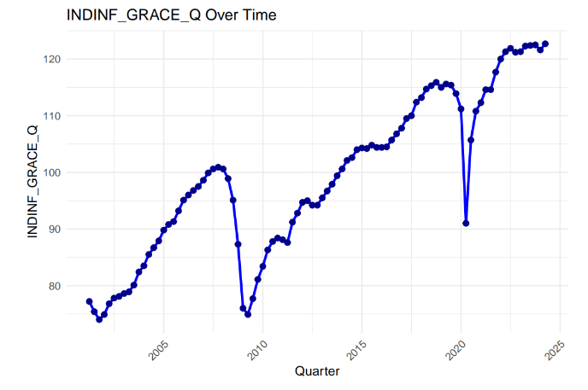
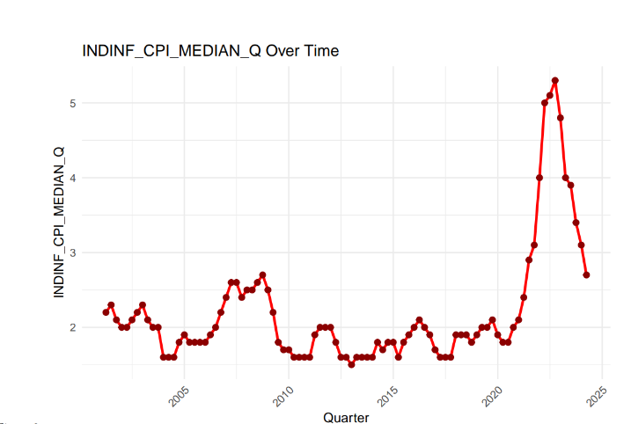
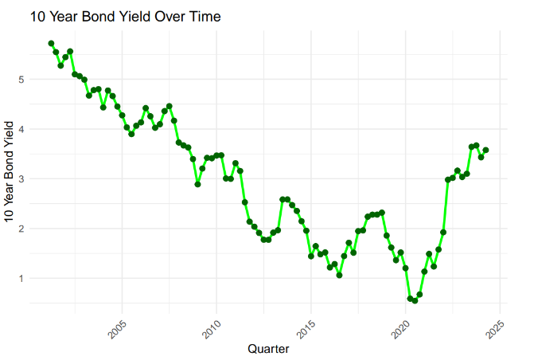
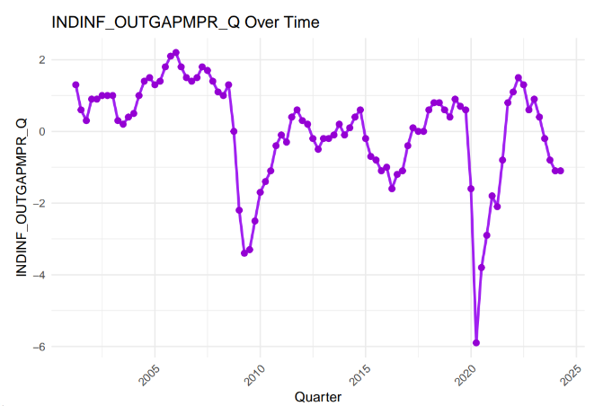
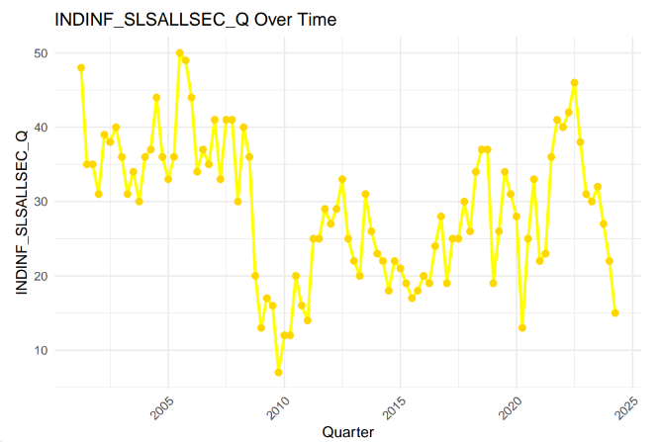
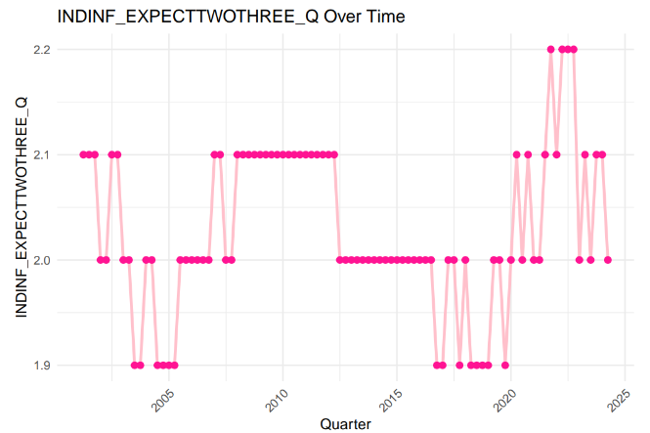
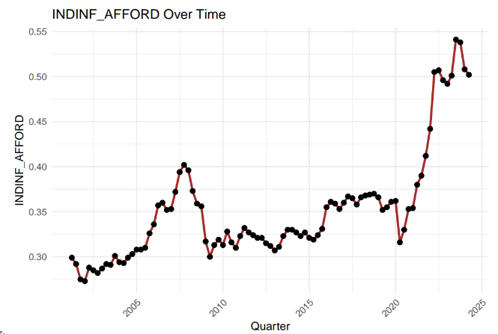
Basic EDA
For the basic EDA, we decided to graph all 7 variables over the quarterly years to take look at the general trends to see if they are correlated with the Housing Affordability Index

Slide 8
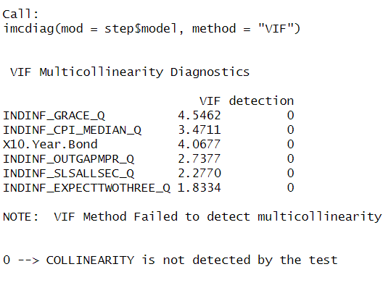
Model Building and Diagnostics
Check for multicollinearity

Slide 9
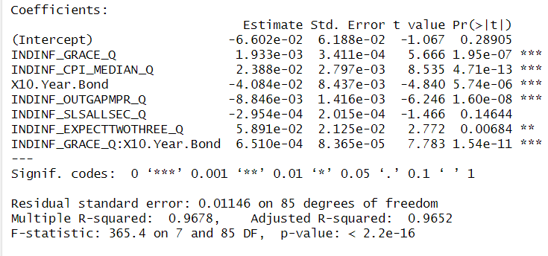

Model Refinement and Validation
Check for interaction effects
Export demand and long term bond yields interaction significant
Positive coefficient is odd given economic theory.

Slide 10
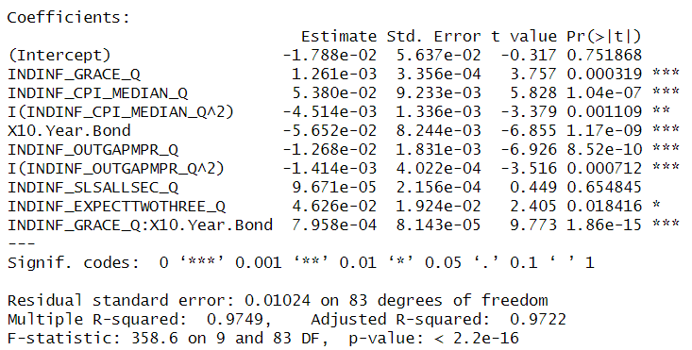
Model Refinement and Validation-cont
Check for higher order relationships
Output gap and export demand

Slide 11

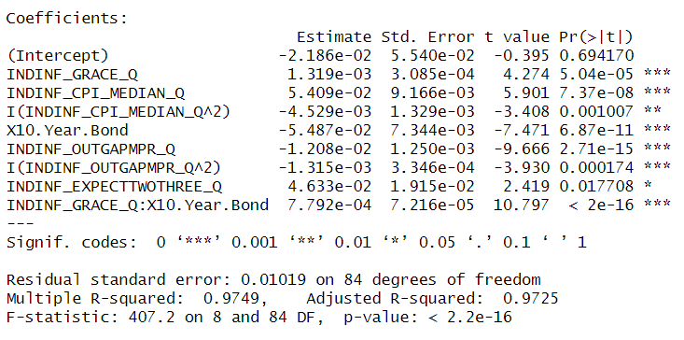
Model Refinement and Validation-cont
Drop insignificant variable
Anova test shows we can drop labor shortage
Final model
RSE: 0.01019
Adj R squared: 0.9725

Slide 12
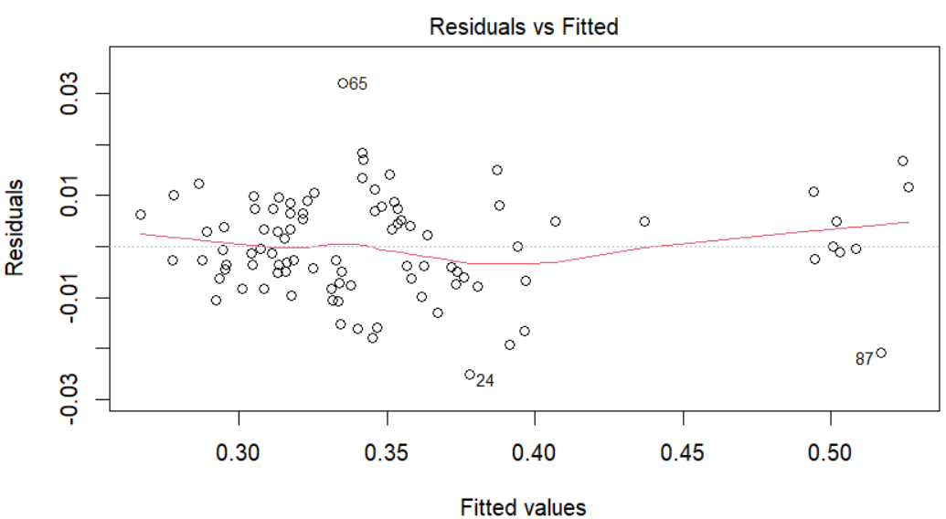
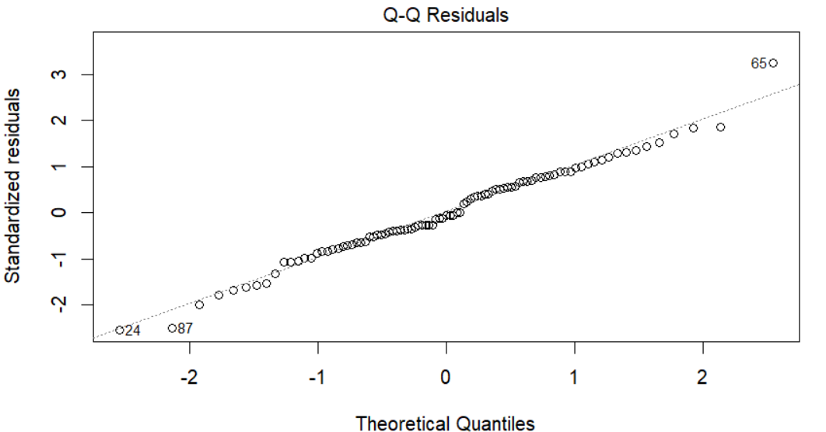
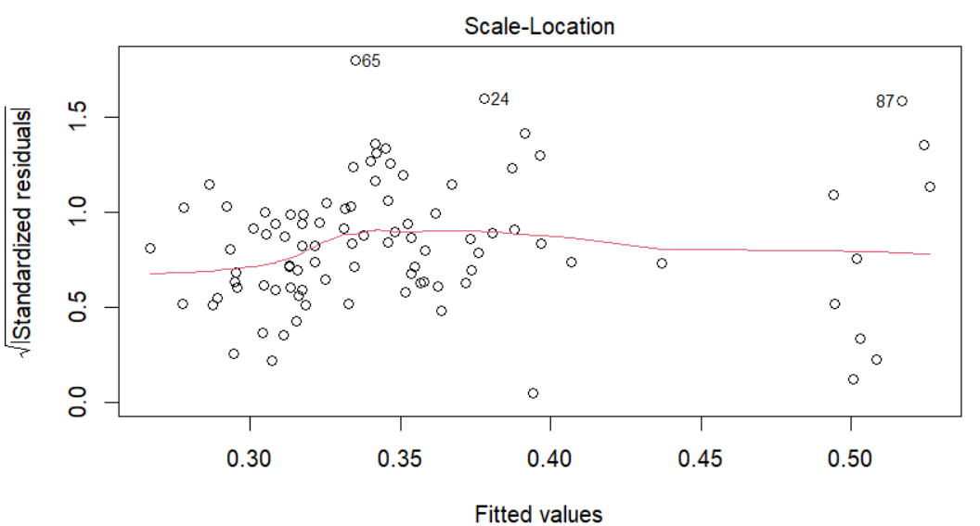
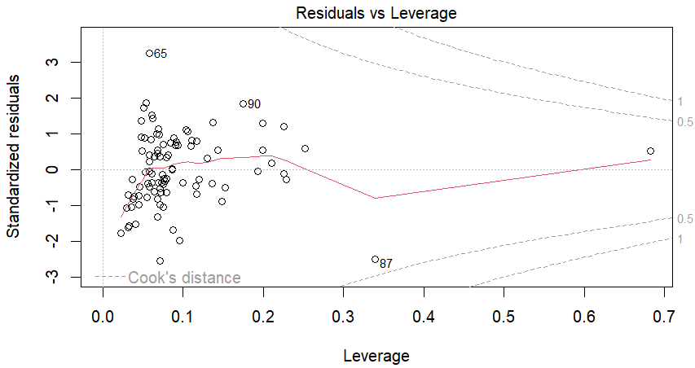
Model Refinement and Validation-cont
Residual plots show our assumptions hold

Slide 13
Conclusions
Stepwise Selection
Final Model
Complex topic
To see what variables would be chosen to predict Housing Affordability Index
Adjusted R Squared: 97.25%
RSE: 0.01019
Only a small snapshot but may be a stepping stone to understanding housing affordability

Slide 14
References
Bank of Canada. (2024, October 23). Capacity and inflation pressures. Bank of Canada https://www.bankofcanada.ca/rates/indicators/capacity-and-inflation-pressures/
Federal Reserve Bank of St. Louis. (n.d.). FRED economic data. Federal Reserve Bank of St. Louis. https://fred.stlouisfed.org/
Government of Canada, Statistics Canada. (2024, October 16). Canada mortgage and Housing Corporation, housing starts, all areas, Canada and provinces, seasonally adjusted at annual rates, monthly. https://www150.statcan.gc.ca/t1/tbl1/en/tv.action?pid=3410015801

